Slide 1
BITS Pilani presentation
K. Venkata Ratnam
Mathematics

Slide 2
Course Number : SS ZC416
Course Title: MATHEMATICAL FOUNDATIONS
FOR DATA SCIENCE
Lecture No. :5

Slide 3
Definition
Let X and Y be any vector spaces.
To each vector x in X we assign a unique vector y in Y. Then we say that a mapping (or transformation or operator) of X into Y is given.
Such a mapping is denoted by a capital letter, say F.
The vector y in Y assigned to a vector x in X is called the image of x under F and is denoted by F (x)

Slide 4
Linear Transformation
F is called a linear mapping or linear transformation if, for all vectors v and x in X and scalars c,
F (v + x) = F (v) + F (x)
F(cx)= cF(x)
Null Space and Nullity are concepts in linear algebra which are used to identify the linear relationship among attributes.

Slide 5
Definitions
For a given matrix A the solution set of the homogeneous system (Ax= 0) is a vector space, called the null space of A, and its dimension is called the nullity of A.
Nullity of A: the number of linearly independent vectors in the null space.
Rank A: For a given matrix A, the maximum number of linearly independent row vectors of A. It is denoted by rank A.

Slide 6
Rank - Nullity theorem
For any m × n matrix A,
rank A + nullity A= n ( Number of columns of A).

Slide 7
Linear Transformation of Space R^{n} into R^{m} Space
Let X= R^{n} and Y=R^{m}. Then any real mXn matrix A= [aij]
gives a transformation of into R^{n} into R^{m},
Y=AX
Since A(u + x) = Au + Ax and A(cx) = cAx, this transformation is linear.
Every linear transformation F of R^{n} into R^{m} can be given
in terms of an mXn matrix A, after a basis for R^{n} and a basis for R^{m} have been chosen.

Slide 8
LT

Slide 9
LT

Slide 10
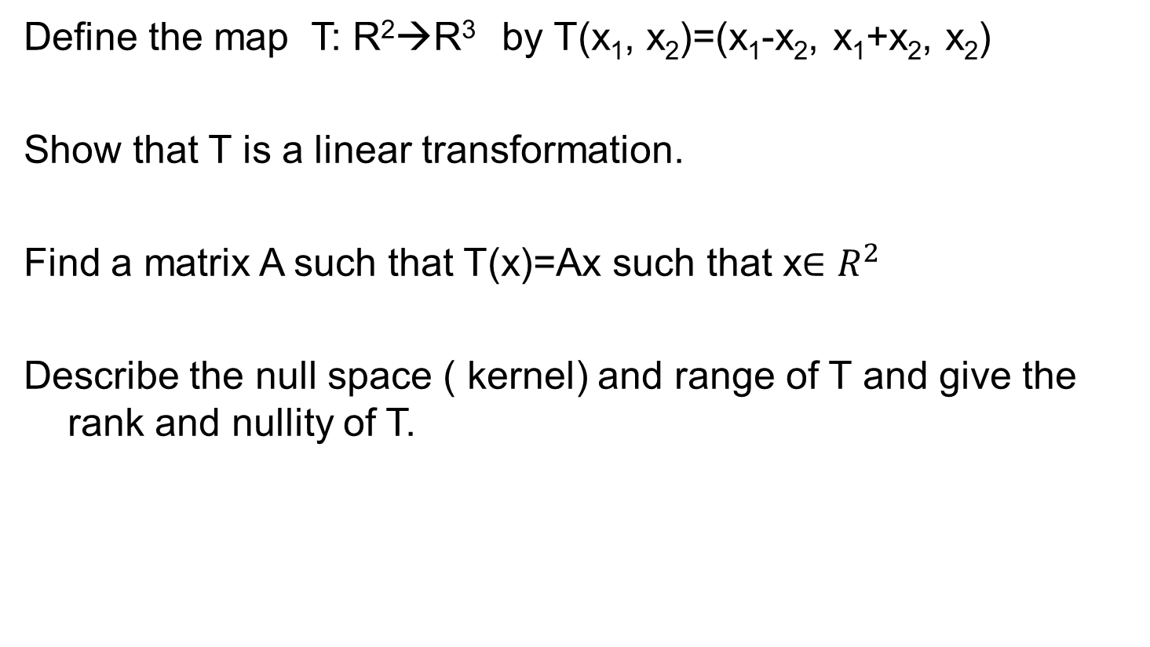
Problem
Define the map T: R²→R³ by T(x₁, x₂)=(x₁-x₂, x₁+x₂, x₂)
Show that T is a linear transformation.
Find a matrix A such that T(x)=Ax such that x$∈R^{2}$
Describe the null space ( kernel) and range of T and give the rank and nullity of T.

Slide 11
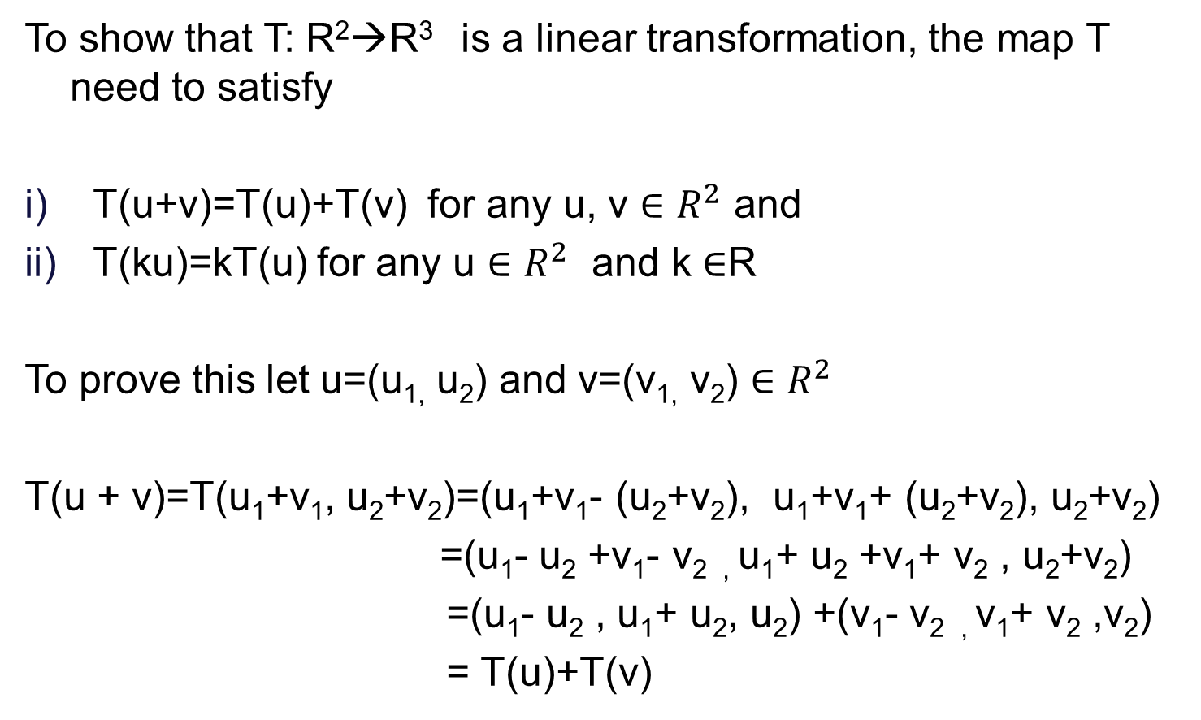
Sol..
To show that T: R²→R³ is a linear transformation, the map T need to satisfy
T(u+v)=T(u)+T(v) for any u, v $∈R^{2}$ and
T(ku)=kT(u) for any u $∈R^{2}$ and k $∈$R
To prove this let u=(u_{1,} u₂) and v=(v_{1,} v₂) $∈R^{2}$
T(u + v)=T(u₁+v₁, u₂+v₂)=(u₁+v₁- (u₂+v₂), u₁+v₁+ (u₂+v₂), u₂+v₂)
=(u₁- u₂ +v₁- v_{2 ,} u₁+ u₂ +v₁+ v₂ , u₂+v₂)
=(u₁- u₂ , u₁+ u₂, u₂) +(v₁- v_{2 ,} v₁+ v₂ ,v₂)
= T(u)+T(v)

Slide 12

Sol..
For any u=(u_{1,} u₂) $∈R^{2}$ and c $∈$R,
T(c u)= T(cu_{1,} cu₂)=(cu₁-cu_{2 ,} cu₁+cu₂, cu₂)= c (u₁- u₂ , u₁+ u₂, u₂)
=cT(u)
Thus T is a linear transformation from R²→R^{3 .}

Slide 13
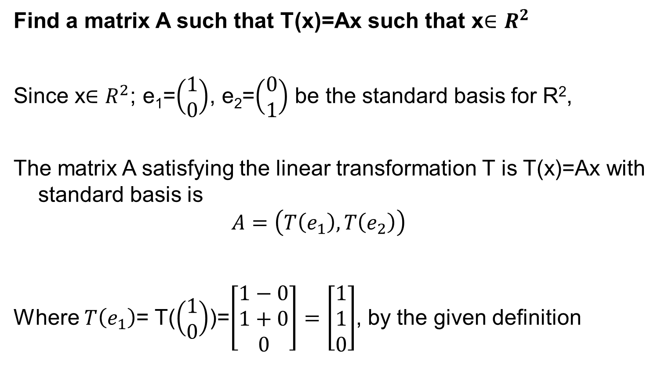
Sol..
Find a matrix A such that T(x)=Ax such that x$∈R^{2}$
Since x$∈R^{2}$; e₁=$\left(\begin{matrix}1 \\ 0\end{matrix}\right)$, e₂=$\left(\begin{matrix}0 \\ 1\end{matrix}\right)$ be the standard basis for R²,
The matrix A satisfying the linear transformation T is T(x)=Ax with standard basis is
$$A=\left(T\left(e_{1}\right),T\left(e_{2}\right)\right)$$
Where $T\left(e_{1}\right)$= T($\left(\begin{matrix}1 \\ 0\end{matrix}\right)$)=$\left[\begin{matrix}1−0 \\ 1+0 \\ 0\end{matrix}\right]=\left[\begin{matrix}1 \\ 1 \\ 0\end{matrix}\right]$, by the given definition

Slide 14

Sol..
$T\left(e_{2}\right)$= T($\left(\begin{matrix}0 \\ 1\end{matrix}\right)$)=$\left[\begin{matrix}0−1 \\ 0+1 \\ 1\end{matrix}\right]=\left[\begin{matrix}−1 \\ 1 \\ 1\end{matrix}\right]$
then A is
$$A=\left[\begin{matrix}1 & −1 \\ 1 & 1 \\ 0 & 1\end{matrix}\right]$$

Slide 15
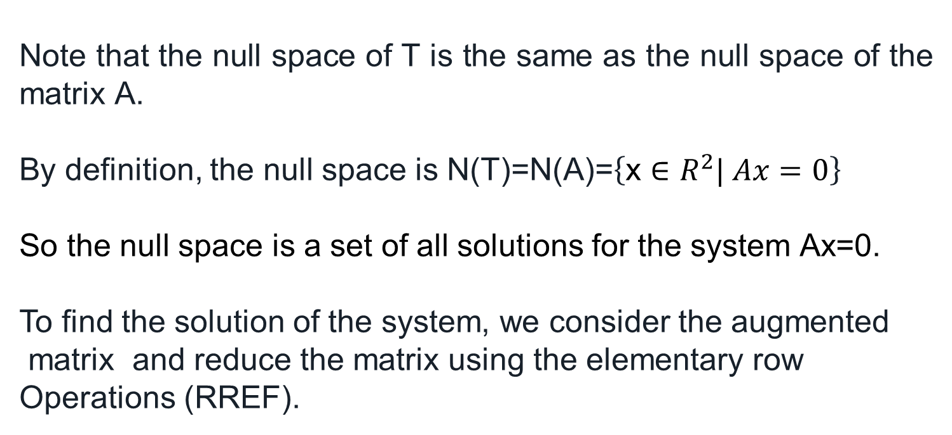
Null Space and Nullity
Note that the null space of T is the same as the null space of the matrix A.
By definition, the null space is N(T)=N(A)=$\left\{\text{x}∈R^{2}| Ax=0\right\}$
So the null space is a set of all solutions for the system Ax=0.
To find the solution of the system, we consider the augmented
matrix and reduce the matrix using the elementary row
Operations (RREF).

Slide 16
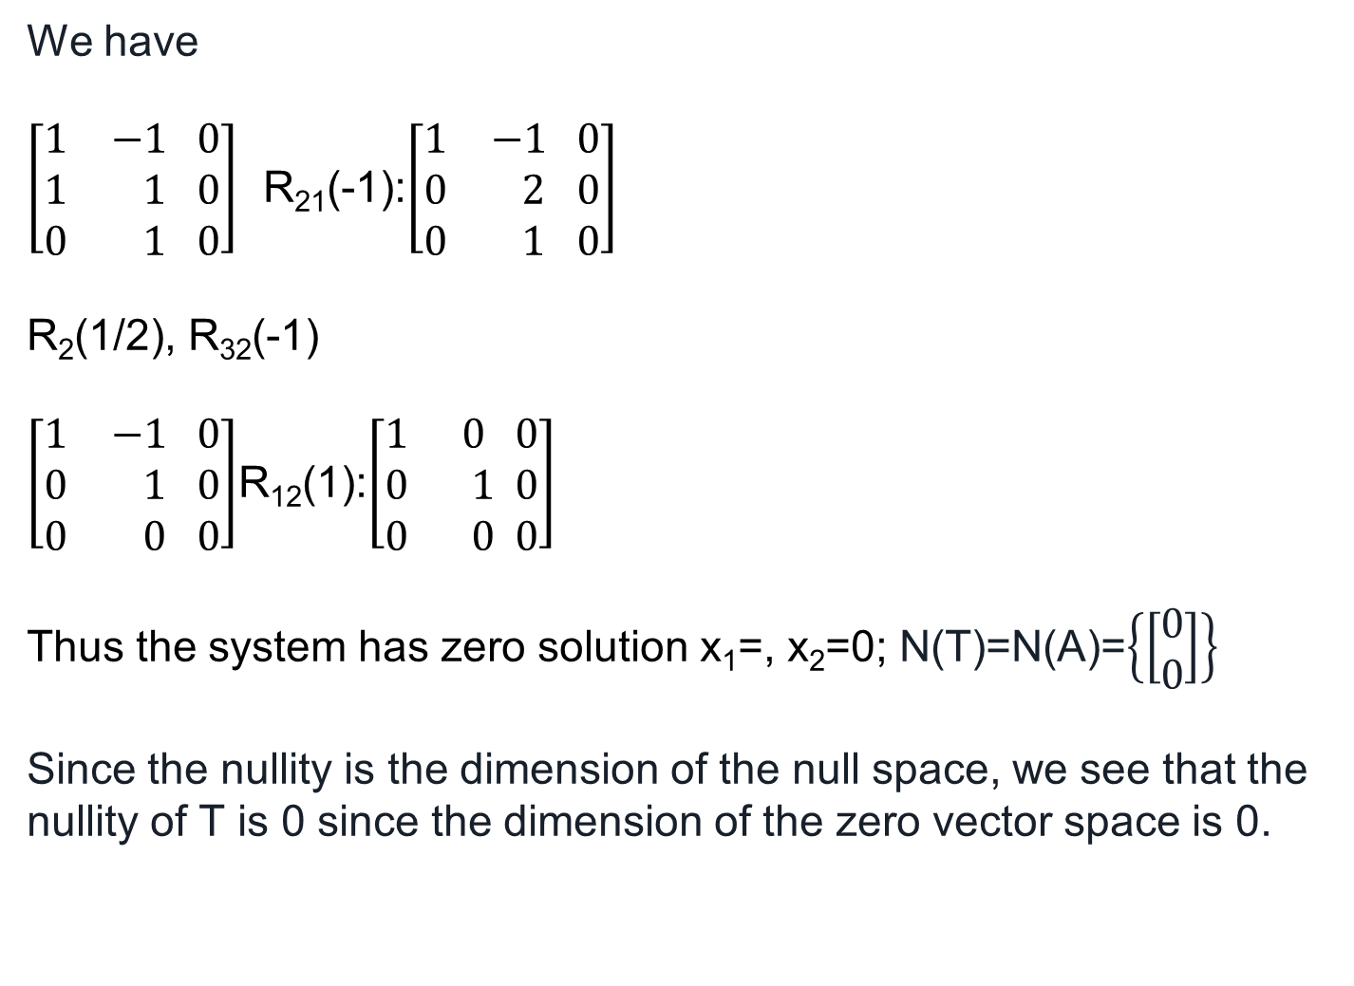
Null space
We have
$\left[\begin{matrix}1 & −1 \\ 1 & 1 \\ 0 & 1\end{matrix}\begin{matrix}0 \\ 0 \\ 0\end{matrix}\right]$ R₂₁(-1):$\left[\begin{matrix}1 & −1 \\ 0 & 2 \\ 0 & 1\end{matrix}\begin{matrix}0 \\ 0 \\ 0\end{matrix}\right]$
R₂(1/2), R₃₂(-1)
$\left[\begin{matrix}1 & −1 \\ 0 & 1 \\ 0 & 0\end{matrix}\begin{matrix}0 \\ 0 \\ 0\end{matrix}\right]$R₁₂(1):$\left[\begin{matrix}1 & 0 \\ 0 & 1 \\ 0 & 0\end{matrix}\begin{matrix}0 \\ 0 \\ 0\end{matrix}\right]$
Thus the system has zero solution x₁=, x₂=0; N(T)=N(A)=$\left\{\left[\begin{matrix}0 \\ 0\end{matrix}\right]\right\}$
Since the nullity is the dimension of the null space, we see that the nullity of T is 0 since the dimension of the zero vector space is 0.

Slide 17
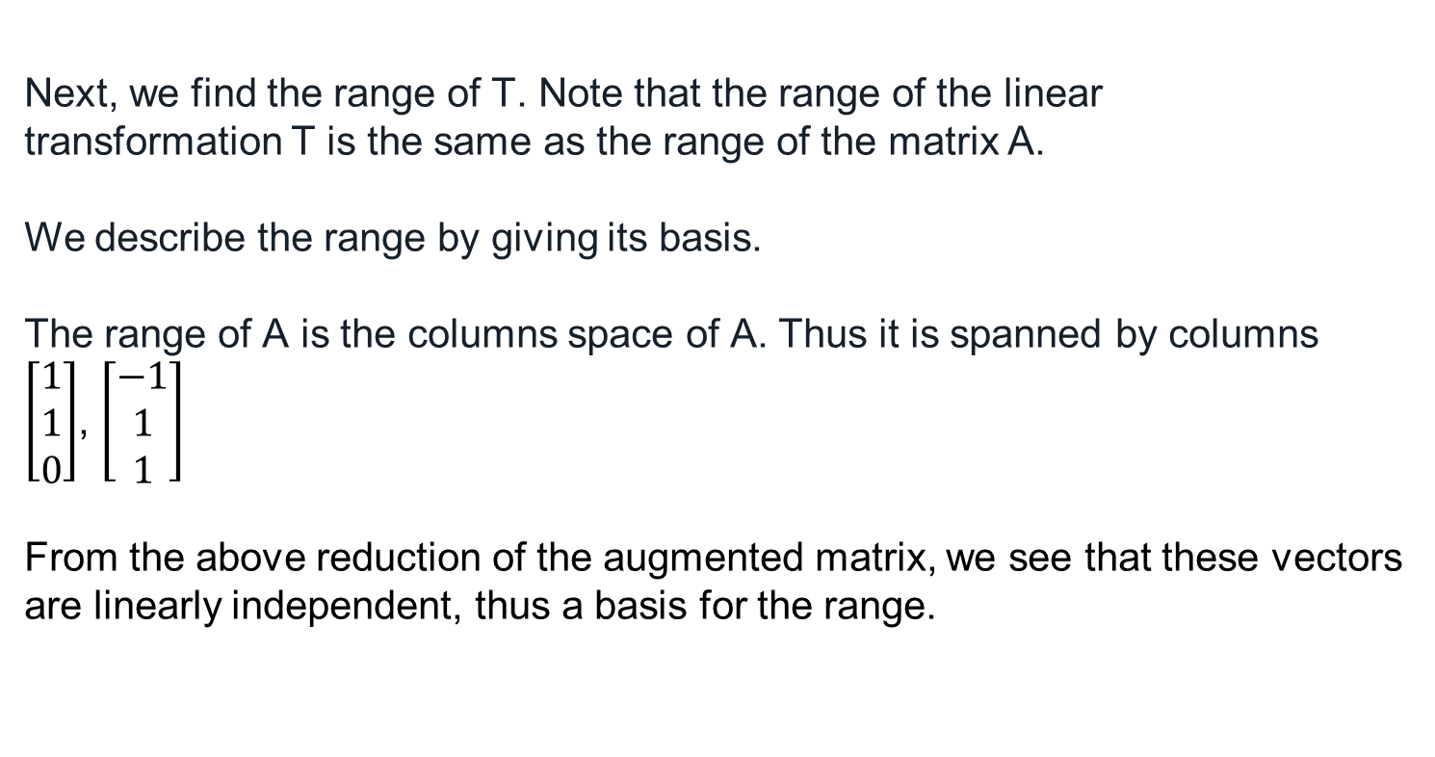
Range:
Next, we find the range of T. Note that the range of the linear transformation T is the same as the range of the matrix A.
We describe the range by giving its basis.
The range of A is the columns space of A. Thus it is spanned by columns
$\left[\begin{matrix}1 \\ 1 \\ 0\end{matrix}\right]$, $\left[\begin{matrix}−1 \\ 1 \\ 1\end{matrix}\right]$
From the above reduction of the augmented matrix, we see that these vectors are linearly independent, thus a basis for the range.

Slide 18
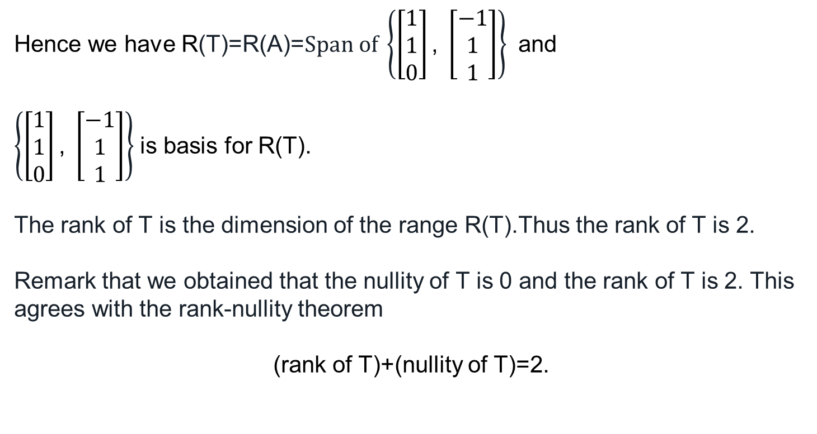
Rank of T
Hence we have R(T)=R(A)=$Span of \left\{\left[\begin{matrix}1 \\ 1 \\ 0\end{matrix}\right]\text{,} \left[\begin{matrix}−1 \\ 1 \\ 1\end{matrix}\right]\right\}$ and
$\left\{\left[\begin{matrix}1 \\ 1 \\ 0\end{matrix}\right]\text{,} \left[\begin{matrix}−1 \\ 1 \\ 1\end{matrix}\right]\right\}$ is basis for R(T).
The rank of T is the dimension of the range R(T).Thus the rank of T is 2.
Remark that we obtained that the nullity of T is 0 and the rank of T is 2. This agrees with the rank-nullity theorem
(rank of T)+(nullity of T)=2.

Slide 19
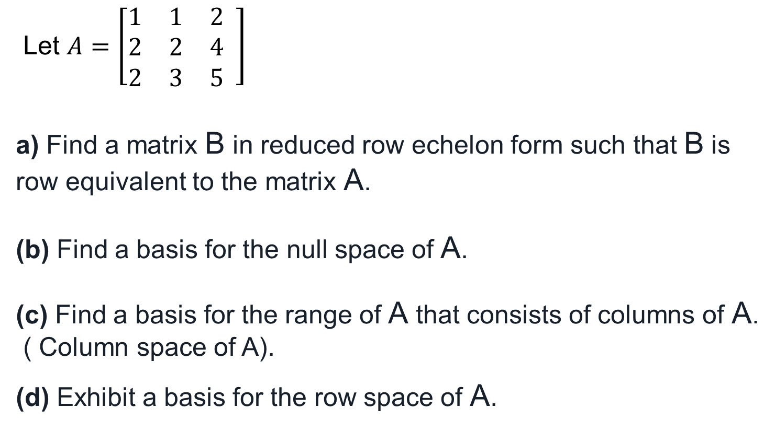
Find a Basis of the Range, Rank, and Nullity of a Matrix
Let $A=\left[\begin{matrix}1 & 1 & 2 \\ 2 & 2 & 4 \\ 2 & 3 & 5\end{matrix} \right]$
a) Find a matrix B in reduced row echelon form such that B is row equivalent to the matrix A.
(b) Find a basis for the null space of A.
(c) Find a basis for the range of A that consists of columns of A.
( Column space of A).
(d) Exhibit a basis for the row space of A.

Slide 20
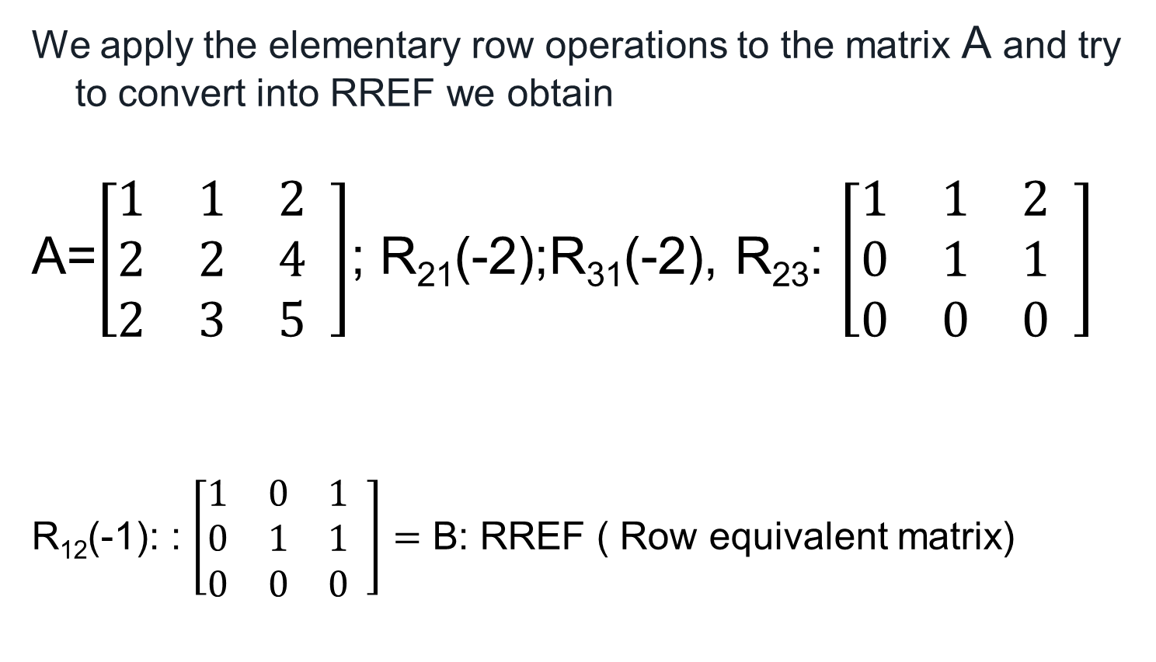
Row equivalent
We apply the elementary row operations to the matrix A and try to convert into RREF we obtain
A=$\left[\begin{matrix}1 & 1 & 2 \\ 2 & 2 & 4 \\ 2 & 3 & 5\end{matrix} \right]$; R₂₁(-2);R₃₁(-2), R₂₃: $\left[\begin{matrix}1 & 1 & 2 \\ 0 & 1 & 1 \\ 0 & 0 & 0\end{matrix} \right]$
R₁₂(-1): : $\left[\begin{matrix}1 & 0 & 1 \\ 0 & 1 & 1 \\ 0 & 0 & 0\end{matrix} \right]=$ B: RREF ( Row equivalent matrix)

Slide 21
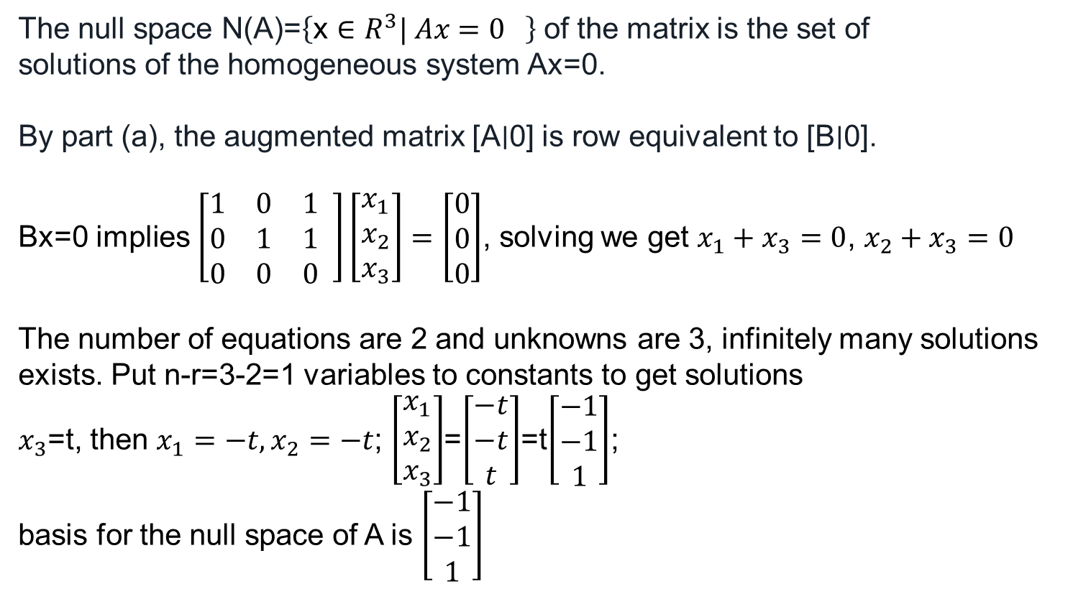
basis for the null space of A
The null space N(A)=$\left\{\text{x}∈R^{3}| Ax=0 \right\}$ of the matrix is the set of
solutions of the homogeneous system Ax=0.
By part (a), the augmented matrix [A∣0] is row equivalent to [B∣0].
Bx=0 implies $\left[\begin{matrix}1 & 0 & 1 \\ 0 & 1 & 1 \\ 0 & 0 & 0\end{matrix} \right]\left[\begin{matrix}x_{1} \\ x_{2} \\ x_{3}\end{matrix}\right]=\left[\begin{matrix}0 \\ 0 \\ 0\end{matrix}\right]$, solving we get $x_{1}+x_{3}=0$, $x_{2}+x_{3}=0$
The number of equations are 2 and unknowns are 3, infinitely many solutions exists. Put n-r=3-2=1 variables to constants to get solutions
$x_{3}$=t, then $x_{1}=−t,x_{2}=−t$; $\left[\begin{matrix}x_{1} \\ x_{2} \\ x_{3}\end{matrix}\right]$=$\left[\begin{matrix}−t \\ −t \\ t\end{matrix}\right]$=t$\left[\begin{matrix}−1 \\ −1 \\ 1\end{matrix}\right]$;
basis for the null space of A is $\left[\begin{matrix}−1 \\ −1 \\ 1\end{matrix}\right]$

Slide 22

a basis for the row space of A.
We already reduced the matrix in row echelon form
$$\left[\begin{matrix}1 & 0 & 1 \\ 0 & 1 & 1 \\ 0 & 0 & 0\end{matrix} \right]$$
The basis for the row space is {(1 0 1), (0 1 1)}.

Slide 23
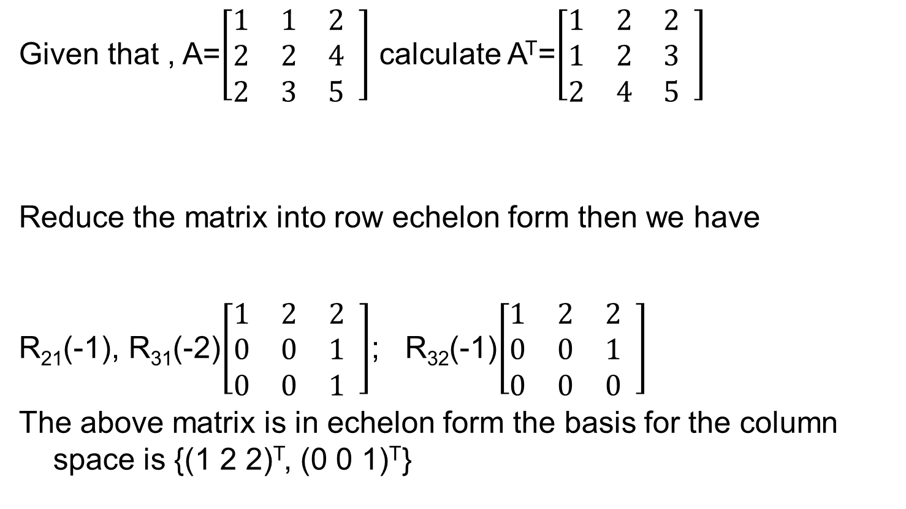
A basis for the column space of A.
Given that , A=$\left[\begin{matrix}1 & 1 & 2 \\ 2 & 2 & 4 \\ 2 & 3 & 5\end{matrix} \right]$ calculate A^{T}=$\left[\begin{matrix}1 & 2 & 2 \\ 1 & 2 & 3 \\ 2 & 4 & 5\end{matrix} \right]$
Reduce the matrix into row echelon form then we have
R₂₁(-1), R₃₁(-2)$\left[\begin{matrix}1 & 2 & 2 \\ 0 & 0 & 1 \\ 0 & 0 & 1\end{matrix} \right]$; R₃₂(-1)$\left[\begin{matrix}1 & 2 & 2 \\ 0 & 0 & 1 \\ 0 & 0 & 0\end{matrix} \right]$
The above matrix is in echelon form the basis for the column space is {(1 2 2)^{T}, (0 0 1)^{T}}

Slide 24
Applications of linear Algebra
Why Study Linear Algebra?
Linear Algebra in Machine Learning
Loss functions
Regularization
Covariance Matrix
Support Vector Machine Classification
Linear Algebra in Dimensionality Reduction
Principal Component Analysis (PCA)
Singular Value Decomposition (SVD)
Linear Algebra in Natural Language Processing
Word Embeddings
Latent Semantic Analysis
Linear Algebra in Computer Vision
Image Representation as Tensors
Convolution and Image Processing

Slide 25
Todays Lecture
Eigen Values and Eigen Vectors

Slide 26
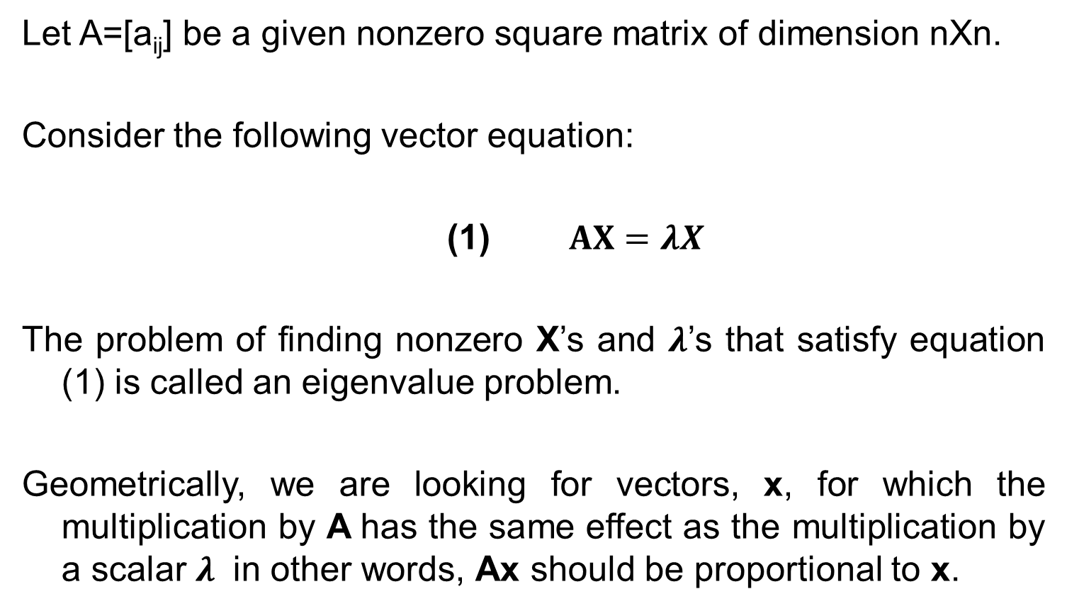
Eigen value
Let A=[a_{ij}] be a given nonzero square matrix of dimension nXn.
Consider the following vector equation:
(1) $AX=λX$
The problem of finding nonzero X’s and $λ$’s that satisfy equation (1) is called an eigenvalue problem.
Geometrically, we are looking for vectors, x, for which the multiplication by A has the same effect as the multiplication by a scalar $λ$ in other words, Ax should be proportional to x.

Slide 27
Applications
Eigenvalues have a very large number of applications in diverse fields such as in engineering, geometry, physics, mathematics, biology, environmental science, economics, psychology, and other areas. You will encounter applications for elastic membranes, Markov processes, population models.
Eigenvectors make understanding linear transformations easy. They are the "axes" (directions) along which a linear transformation acts simply by "stretching/compressing" and/or "flipping"; eigenvalues give you the factors by which this compression occurs.
Stability analysis, vibration analysis, atomic orbitals, facial recognition, and matrix diagonalization.

Slide 28
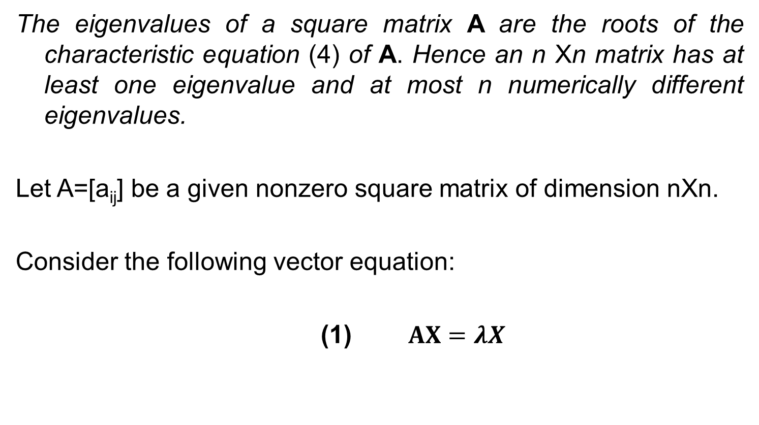
Finding Eigenvalues
The eigenvalues of a square matrix A are the roots of the characteristic equation (4) of A. Hence an n Xn matrix has at least one eigenvalue and at most n numerically different eigenvalues.
Let A=[a_{ij}] be a given nonzero square matrix of dimension nXn.
Consider the following vector equation:
(1) $AX=λX$

Slide 29
Eigen Values

Slide 31
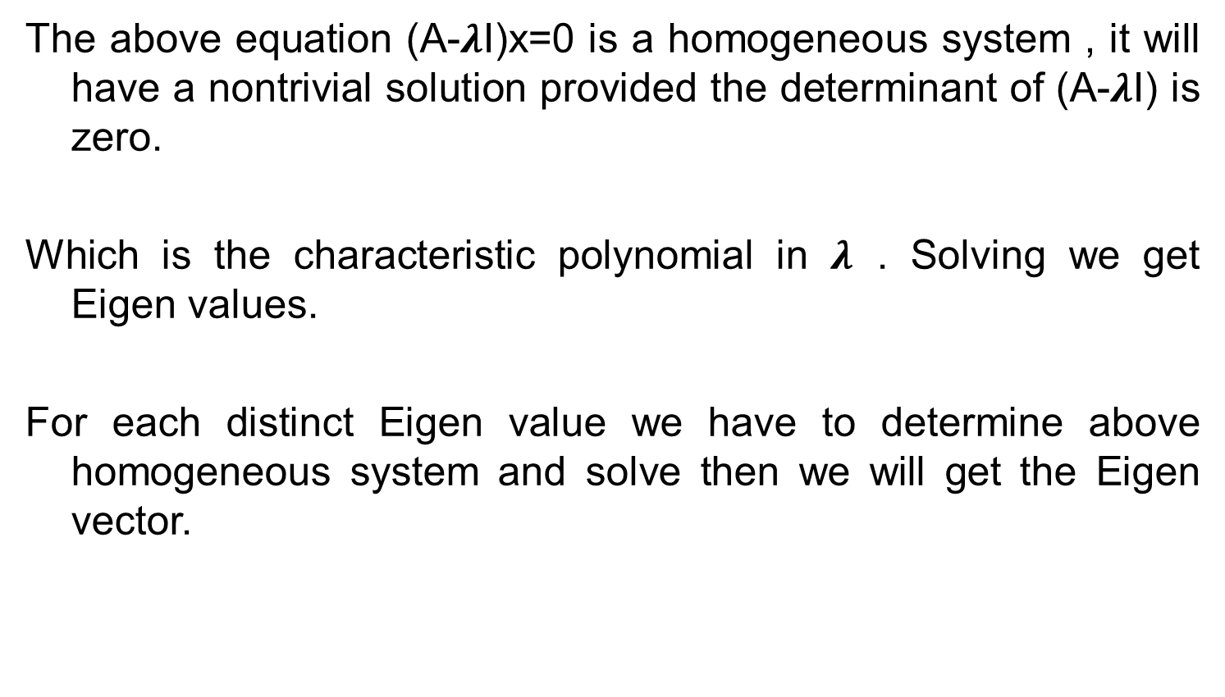
Eigen Values
The above equation (A-$λ$I)x=0 is a homogeneous system , it will have a nontrivial solution provided the determinant of (A-$λ$I) is zero.
Which is the characteristic polynomial in $λ$ . Solving we get Eigen values.
For each distinct Eigen value we have to determine above homogeneous system and solve then we will get the Eigen vector.

Slide 32
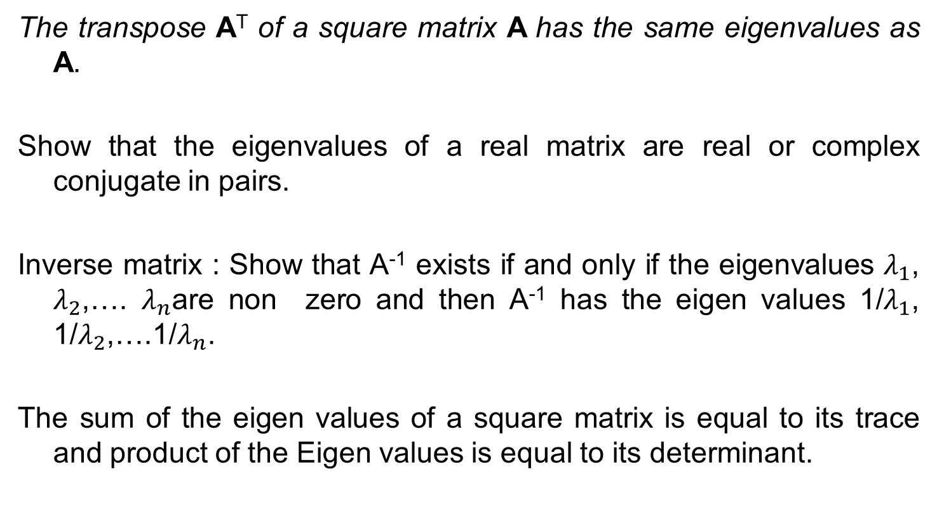
Theorems
The transpose A^{T} of a square matrix A has the same eigenvalues as A.
Show that the eigenvalues of a real matrix are real or complex conjugate in pairs.
Inverse matrix : Show that A⁻¹ exists if and only if the eigenvalues $λ_{1}$, $λ_{2}$,…. $λ_{n}$are non zero and then A⁻¹ has the eigen values 1/$λ_{1}$, 1/$λ_{2}$,….1/$λ_{n}$.
The sum of the eigen values of a square matrix is equal to its trace and product of the Eigen values is equal to its determinant.

Slide 33

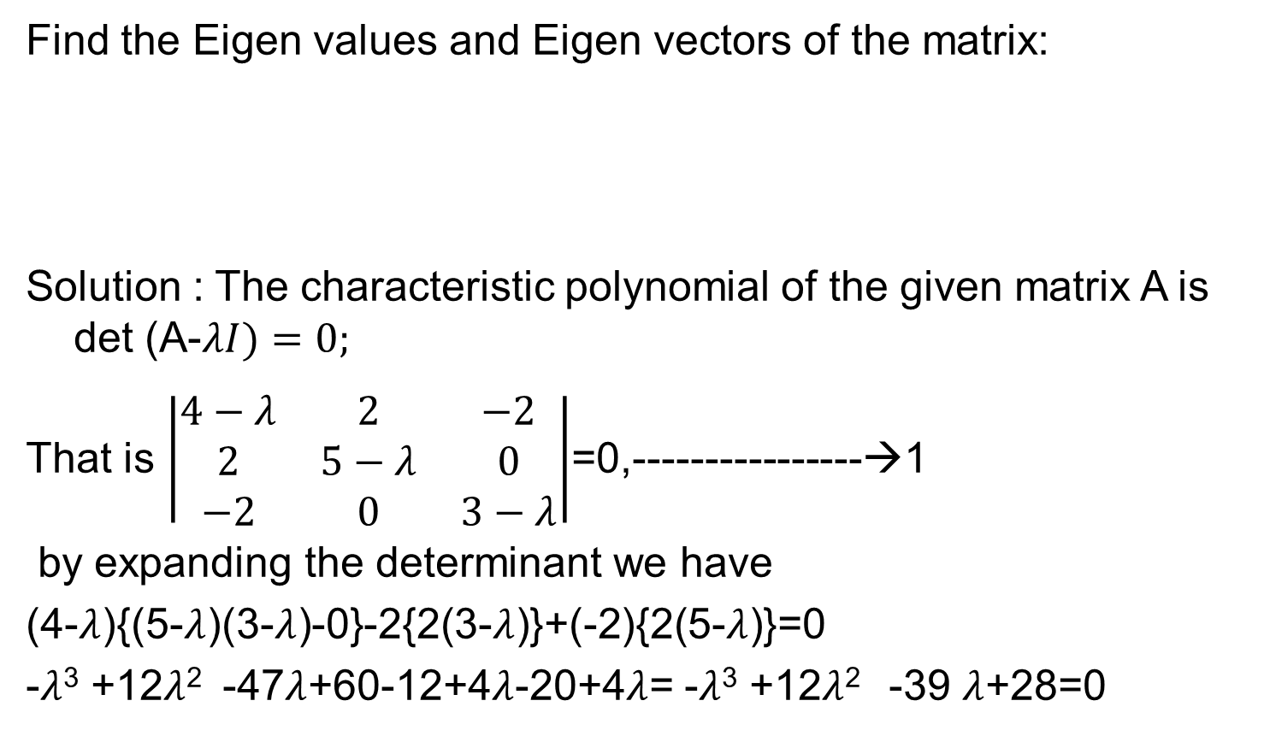
Example
Find the Eigen values and Eigen vectors of the matrix:
Solution : The characteristic polynomial of the given matrix A is det (A-$λI)=0;$
That is $\left|\begin{matrix}4−λ & 2 & −2 \\ 2 & 5−λ & 0 \\ −2 & 0 & 3−λ\end{matrix}\right|$=0,----------------→1
by expanding the determinant we have
(4-$λ$){(5-$λ$)(3-$λ$)-0}-2{2(3-$λ$)}+(-2){2(5-$λ$)}=0
-$λ$³ +12$λ$² -47$λ$+60-12+4$λ$-20+4$λ$= -$λ$³ +12$λ$² -39 $λ$+28=0
$$\left(\begin{matrix}4 & 2 & −2 \\ 2 & 5 & 0 \\ −2 & 0 & 3\end{matrix}\right)$$

Slide 34
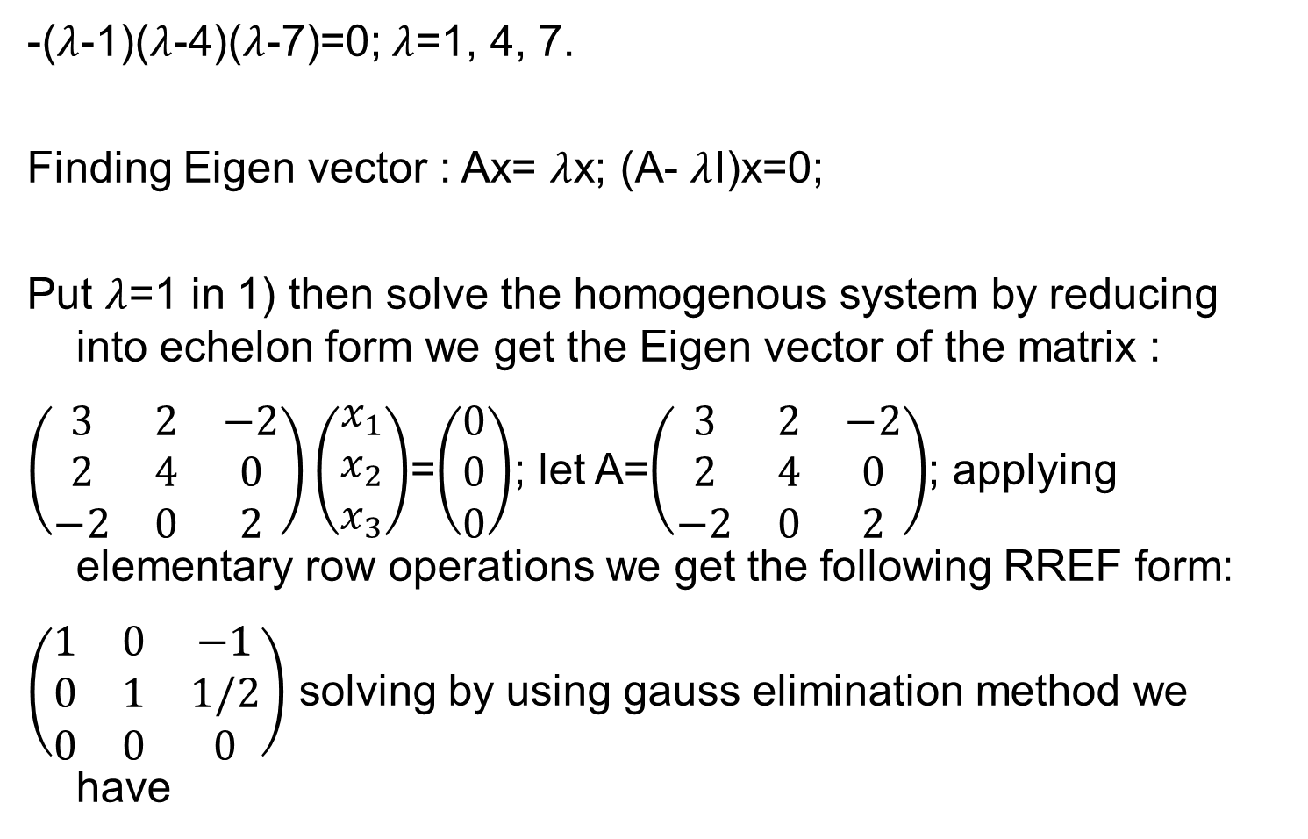
Sol.
-($λ$-1)($λ$-4)($λ$-7)=0; $λ$=1, 4, 7.
Finding Eigen vector : Ax= $λ$x; (A- $λ$I)x=0;
Put $λ$=1 in 1) then solve the homogenous system by reducing into echelon form we get the Eigen vector of the matrix :
$\left(\begin{matrix}3 & 2 & −2 \\ 2 & 4 & 0 \\ −2 & 0 & 2\end{matrix}\right)\left(\begin{matrix}x_{1} \\ x_{2} \\ x_{3}\end{matrix}\right)$=$\left(\begin{matrix}0 \\ 0 \\ 0\end{matrix}\right)$; let A=$\left(\begin{matrix}3 & 2 & −2 \\ 2 & 4 & 0 \\ −2 & 0 & 2\end{matrix}\right)$; applying elementary row operations we get the following RREF form:
$\left(\begin{matrix}1 & 0 & −1 \\ 0 & 1 & 1/2 \\ 0 & 0 & 0\end{matrix}\right)$ solving by using gauss elimination method we have

Slide 35
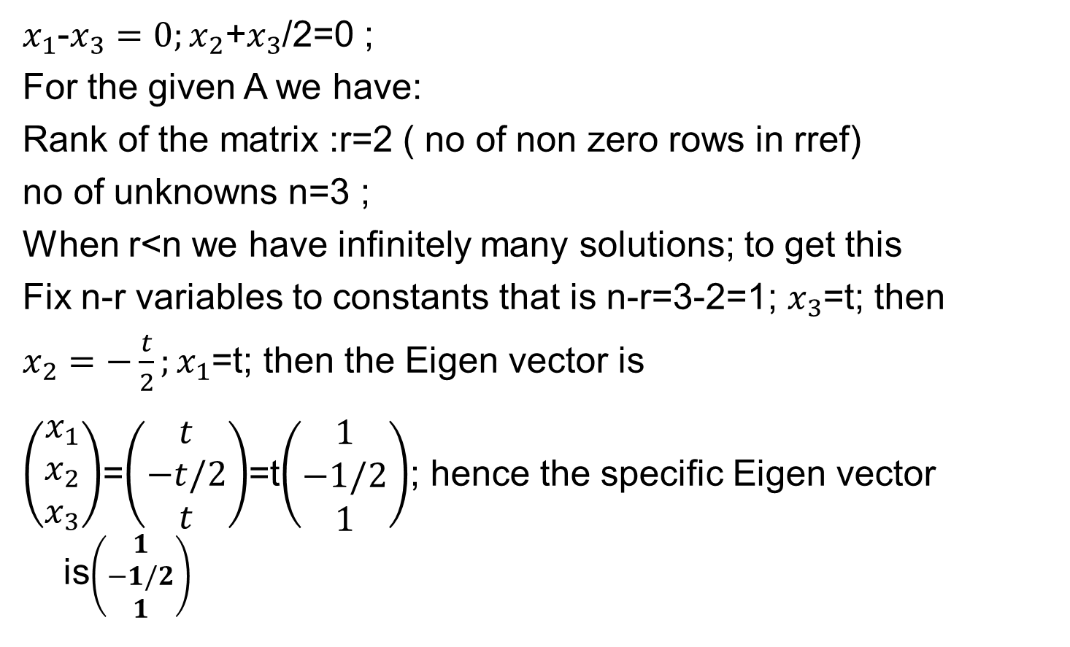
Sol.
$x_{1}$-$x_{3}=0;x_{2}$+$x_{3}$/2=0 ;
For the given A we have:
Rank of the matrix :r=2 ( no of non zero rows in rref)
no of unknowns n=3 ;
When r<n we have infinitely many solutions; to get this
Fix n-r variables to constants that is n-r=3-2=1; $x_{3}$=t; then
$x_{2}=−\frac{t}{2};x_{1}$=t; then the Eigen vector is
$\left(\begin{matrix}x_{1} \\ x_{2} \\ x_{3}\end{matrix}\right)$=$\left(\begin{matrix}t \\ −t/2 \\ t\end{matrix}\right)$=t$\left(\begin{matrix}1 \\ −1/2 \\ 1\end{matrix}\right)$; hence the specific Eigen vector is$\left(\begin{matrix}1 \\ −1/2 \\ 1\end{matrix}\right)$

Slide 36
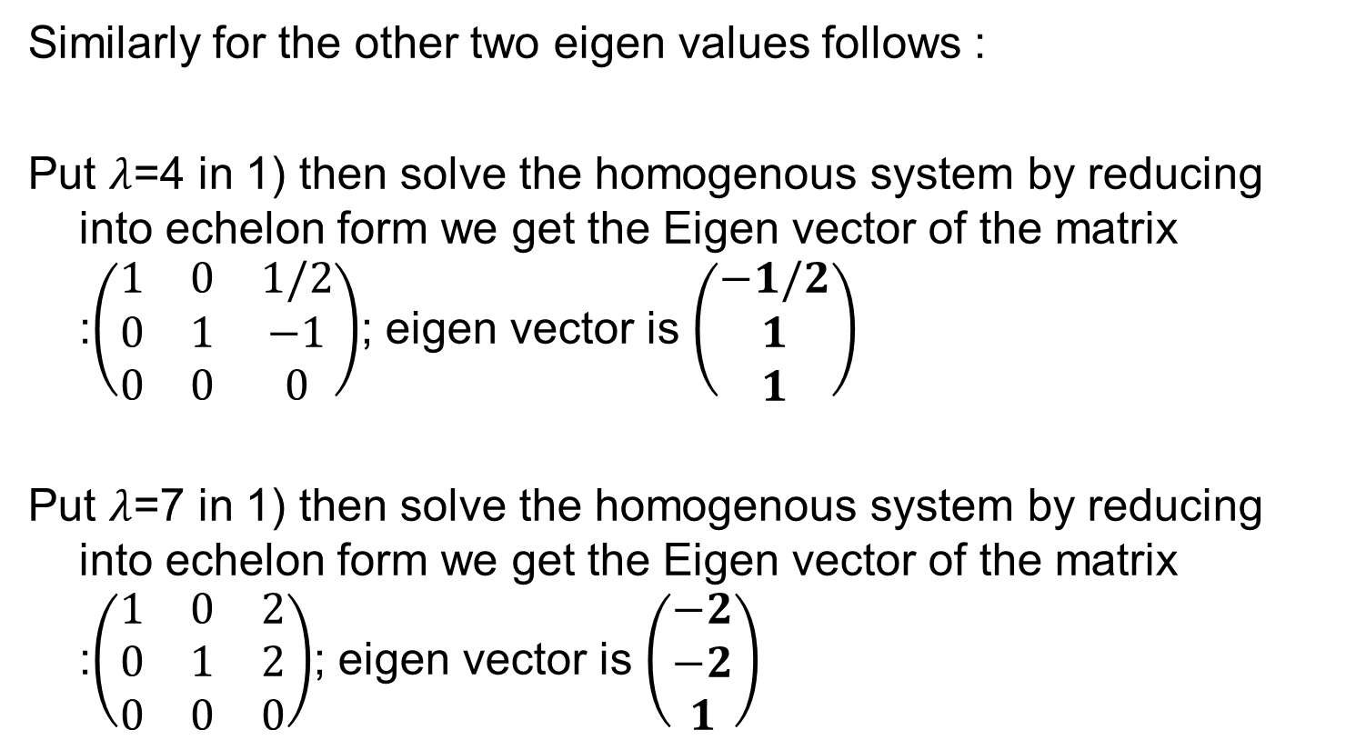
Sol.
Similarly for the other two eigen values follows :
Put $λ$=4 in 1) then solve the homogenous system by reducing into echelon form we get the Eigen vector of the matrix :$\left(\begin{matrix}1 & 0 & 1/2 \\ 0 & 1 & −1 \\ 0 & 0 & 0\end{matrix}\right)$; eigen vector is $\left(\begin{matrix}−1/2 \\ 1 \\ 1\end{matrix}\right)$
Put $λ$=7 in 1) then solve the homogenous system by reducing into echelon form we get the Eigen vector of the matrix :$\left(\begin{matrix}1 & 0 & 2 \\ 0 & 1 & 2 \\ 0 & 0 & 0\end{matrix}\right)$; eigen vector is $\left(\begin{matrix}−2 \\ −2 \\ 1\end{matrix}\right)$

Slide 37
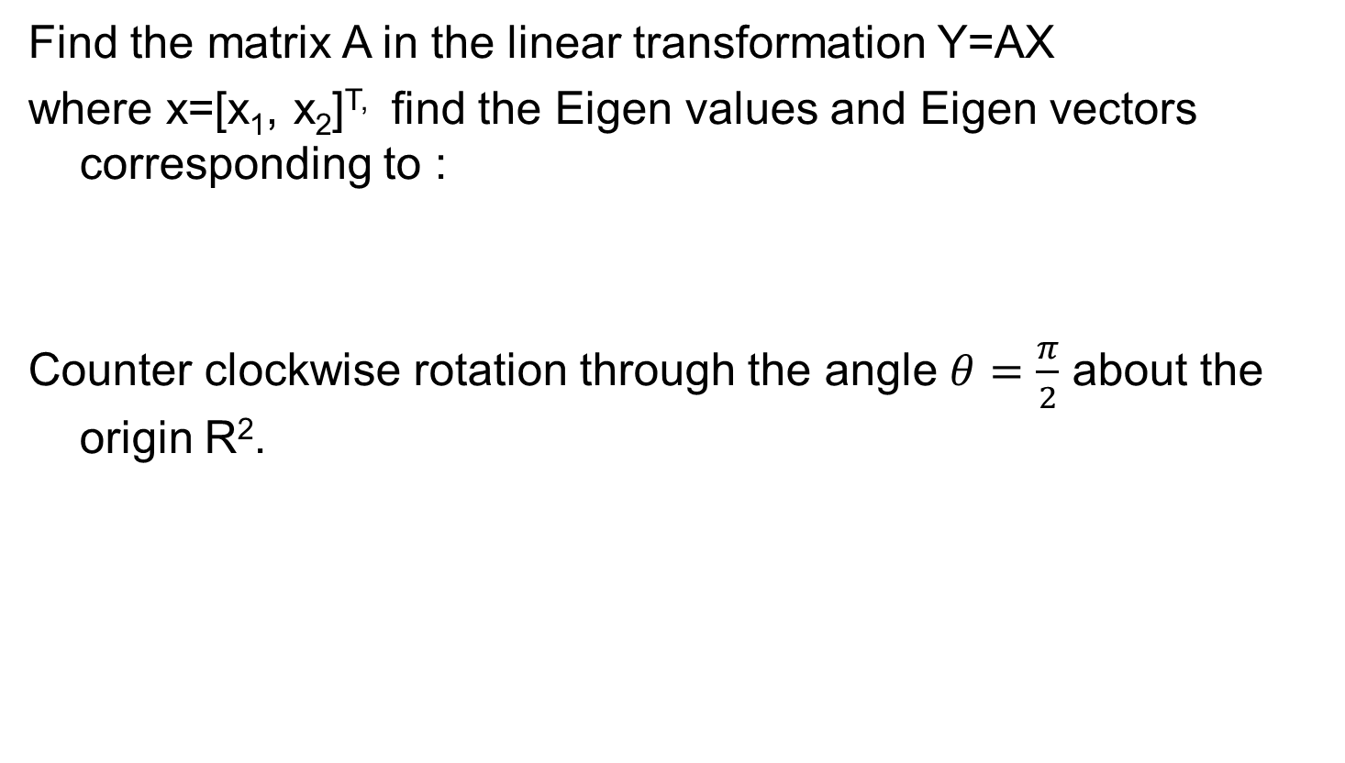
Example 2
Find the matrix A in the linear transformation Y=AX
where x=[x₁, x₂]^{T,} find the Eigen values and Eigen vectors corresponding to :
Counter clockwise rotation through the angle $θ=\frac{π}{2}$ about the origin R².

Slide 38

Example 3
Find the Eigen values and Eigen vectors of the matrix:
$$\left(\begin{matrix}−1 & 0 & 12 \\ 0 & −1 & 0 \\ \begin{aligned}0 \\ 0\end{aligned} & \begin{aligned}0 \\ 0\end{aligned} & \begin{aligned}−1 \\ −4\end{aligned}\end{matrix} \begin{matrix}0 \\ 12 \\ \begin{aligned}−4 \\ −1\end{aligned}\end{matrix}\right)$$

Slide 39
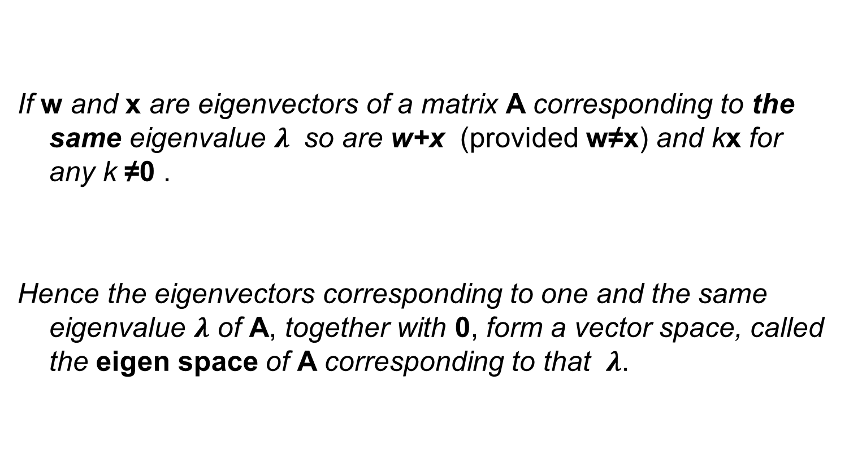
Eigenvectors, Eigen space
If w and x are eigenvectors of a matrix A corresponding to the same eigenvalue $λ$ so are w+x (provided w≠x) and kx for any k ≠0 .
Hence the eigenvectors corresponding to one and the same eigenvalue $λ$ of A, together with 0, form a vector space, called the eigen space of A corresponding to that $λ$.

Slide 40
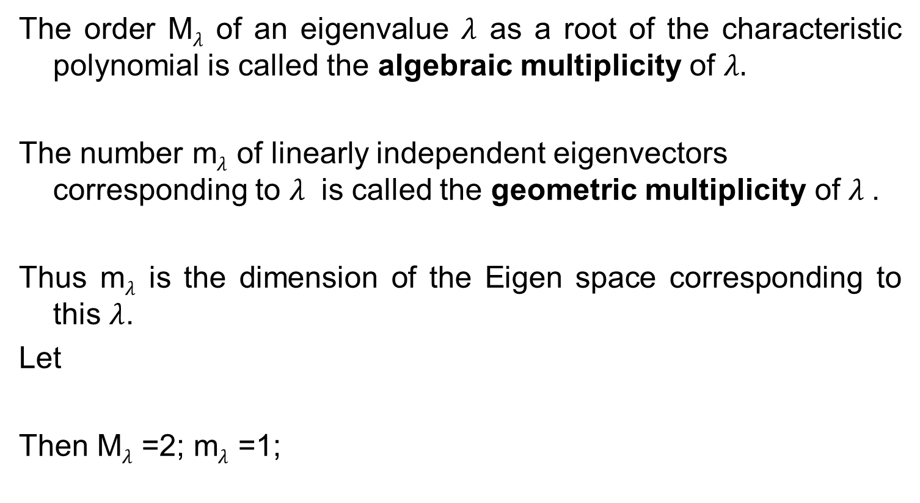
Algebraic multiplicity
Geometric multiplicity
The order M$λ$ of an eigenvalue $λ$ as a root of the characteristic polynomial is called the algebraic multiplicity of $λ.$
The number m$λ$ of linearly independent eigenvectors corresponding to $λ$ is called the geometric multiplicity of $λ$.
Thus m$λ$ is the dimension of the Eigen space corresponding to this $λ$.
Let
Then M$λ$ =2; m$λ$ =1;

